Slide 1
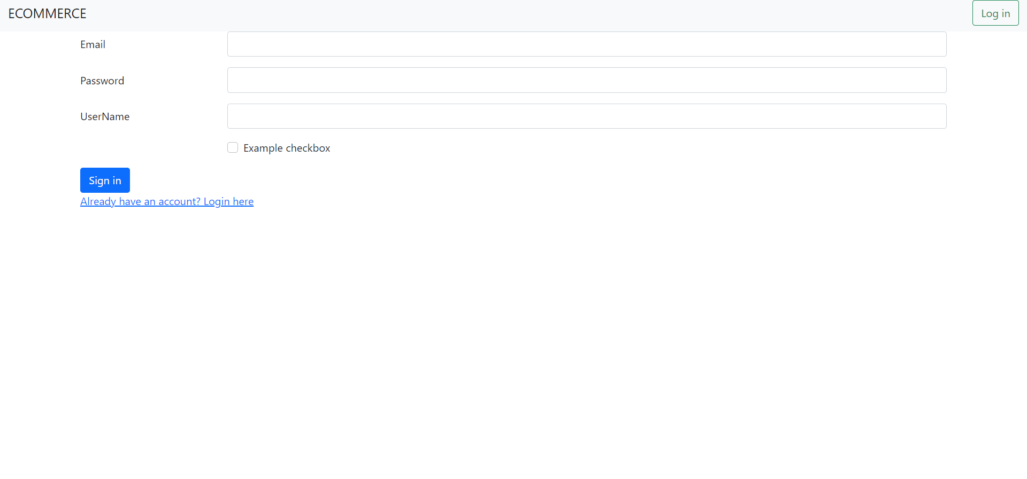
BUILDING AN E-COMMERCE WEBSITE • The Front-End of the website is developed by HTML, CSS and Bootstrap. • And I developed a login page using Bootstrap Starter Template and Nav bar .

Slide 2
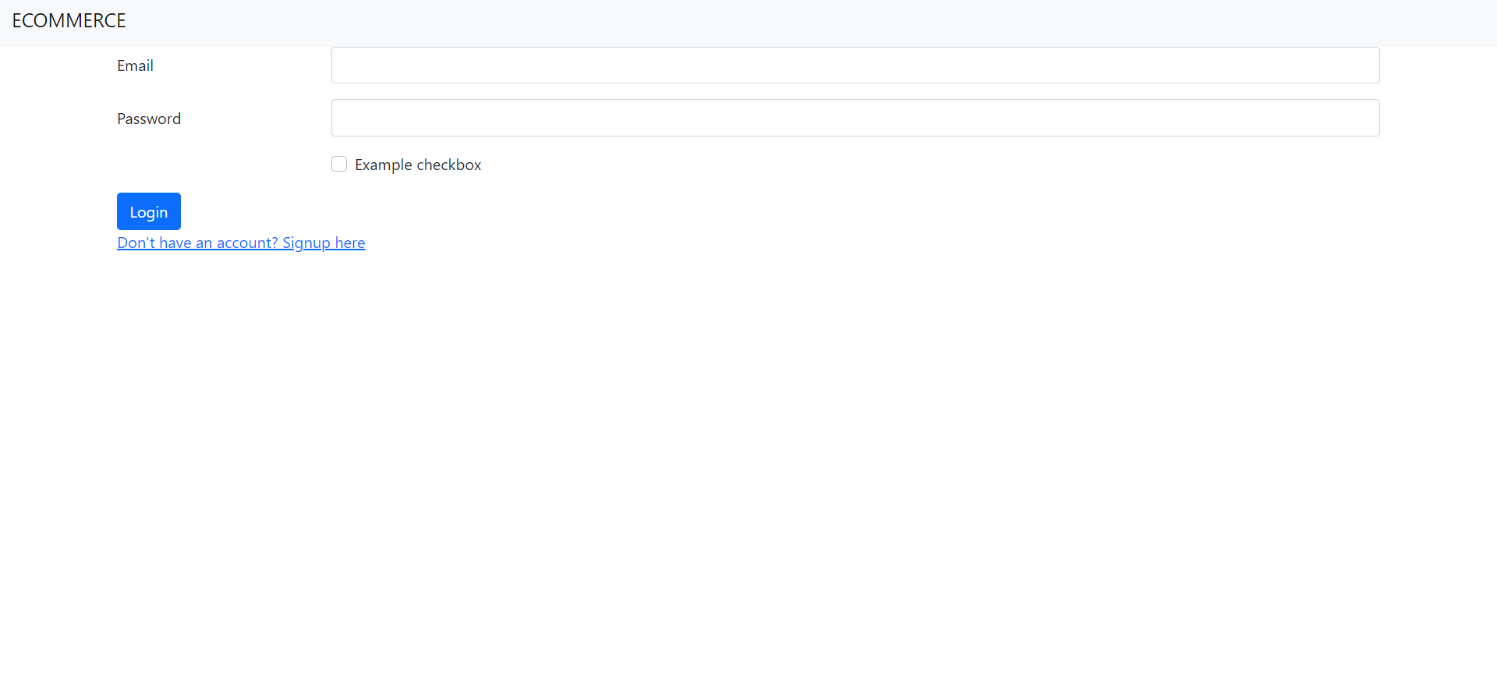
• And I developed a signup page using Bootstrap Starter Template and Horizontal forms.

Slide 3
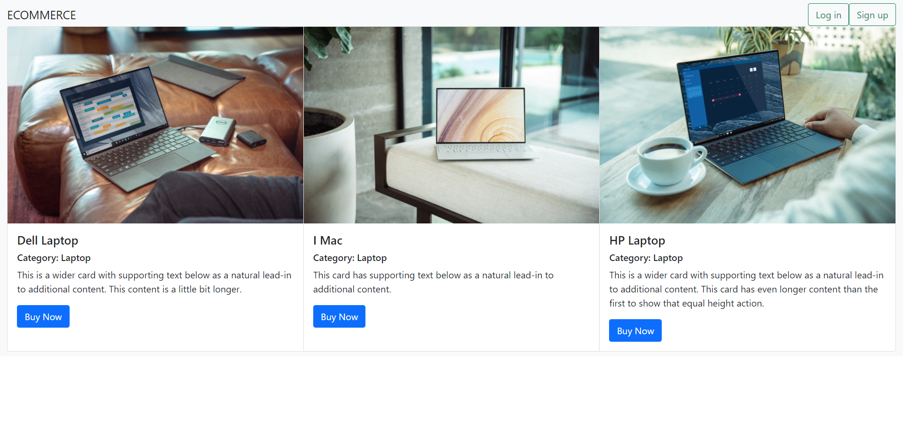
• Next Tasks is to form an index page of a website, so I used Bootstrap Components Cards.

Slide 4
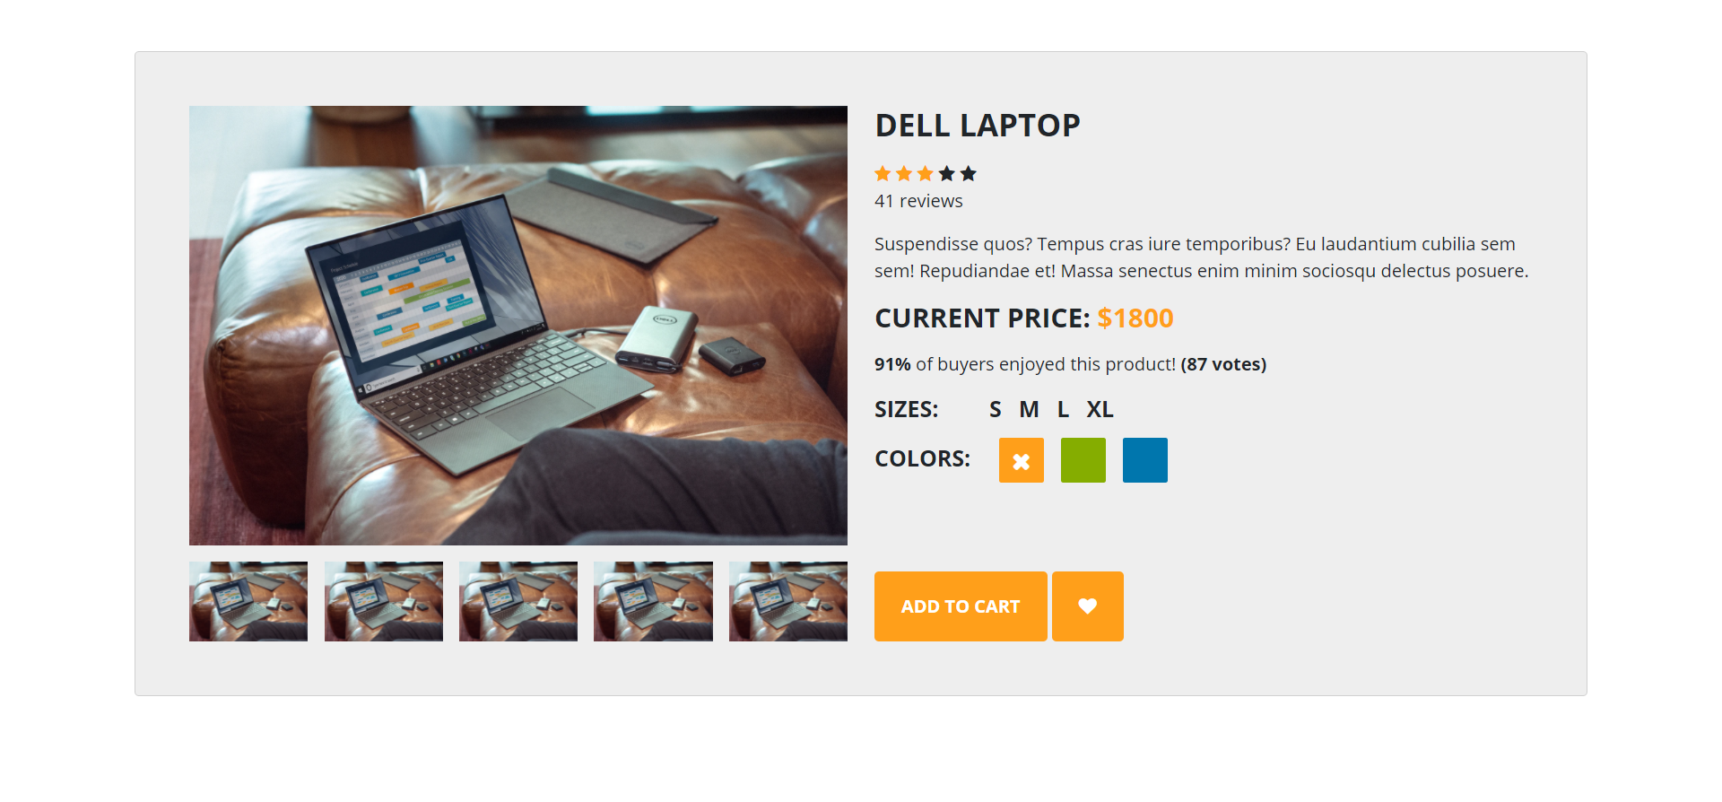
• I created a product details webpage by using Bootstrap view details template.

Slide 5
• I got the pictures from unleash.com and I use
sublime text 4 for execution.
• I added many changes as per in the lesson videos.
I got stop from created a front end of website only and I
didn’t know to continue the backend of website
creation. And I try to do it by seeing the YouTube
videos but I didn’t have that much to finish the task in
time. Sorry for the inconvenience.

